Slide 1

JUSTFAIR North Carolina
Duke University Masters in Interdisciplinary Science / Statistics

Slide 2
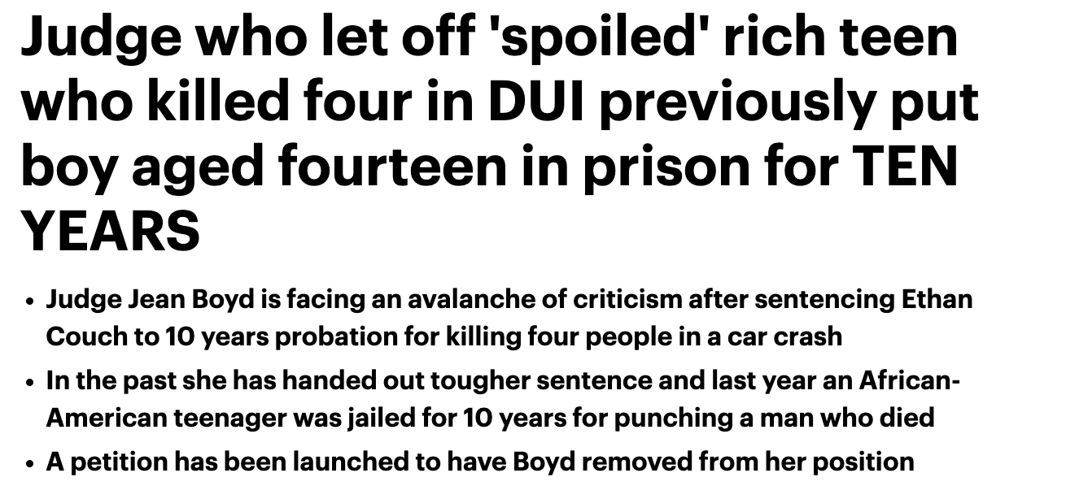
Straight from the headlines

Slide 3

1. How can racial bias manifest in criminal sentencing?
2. What DIFFERENCES exists between court houses in different districts?

Slide 4


Married with
ACIS Data
Census Data
County Demographics
Criminal sentences from 2017-2021

Slide 5



How can we quantify racial/gender bias?
Sentencing, or prison, is probably the first word that you would think of when we talk about crime. So let's start from this very end result that one defendant can receive throughout this process.
Police
Prosecutor
Judge
Who is arrested?
Whose charges are dropped?
Who gets sentenced to longer times in prison?
Notes:
Prosecutor duties by American Bar Association: https://www.americanbar.org/groups/criminal_justice/standards/ProsecutionFunctionFourthEdition/#:~:text=The%20prosecutor%20should%20seek%20to,persons%2C%20including%20suspects%20and%20defendants.
“the prosecutor's primary function is to initiate and conduct criminal action, to act as a party in judicial proceedings and, in many countries, to supervise and direct the police during the investigative phase. In some criminal justice systems, prosecutors also: ensure that victims are effectively assisted; decide on alternatives to prosecution; offer assistance to the court in reaching its decision as to the appropriate sentence; supervise the execution of court decisions.”
States are not required to charge by use of a grand jury.

Slide 6
How can we quantify racial/gender bias?
Police
Prosecutor
Judge
Who is arrested?
Whose charges are dropped?
Who gets sentenced to longer times in prison?
Notes:
Prosecutor duties by American Bar Association: https://www.americanbar.org/groups/criminal_justice/standards/ProsecutionFunctionFourthEdition/#:~:text=The%20prosecutor%20should%20seek%20to,persons%2C%20including%20suspects%20and%20defendants.
“the prosecutor's primary function is to initiate and conduct criminal action, to act as a party in judicial proceedings and, in many countries, to supervise and direct the police during the investigative phase. In some criminal justice systems, prosecutors also: ensure that victims are effectively assisted; decide on alternatives to prosecution; offer assistance to the court in reaching its decision as to the appropriate sentence; supervise the execution of court decisions.”
States are not required to charge by use of a grand jury.

Slide 7
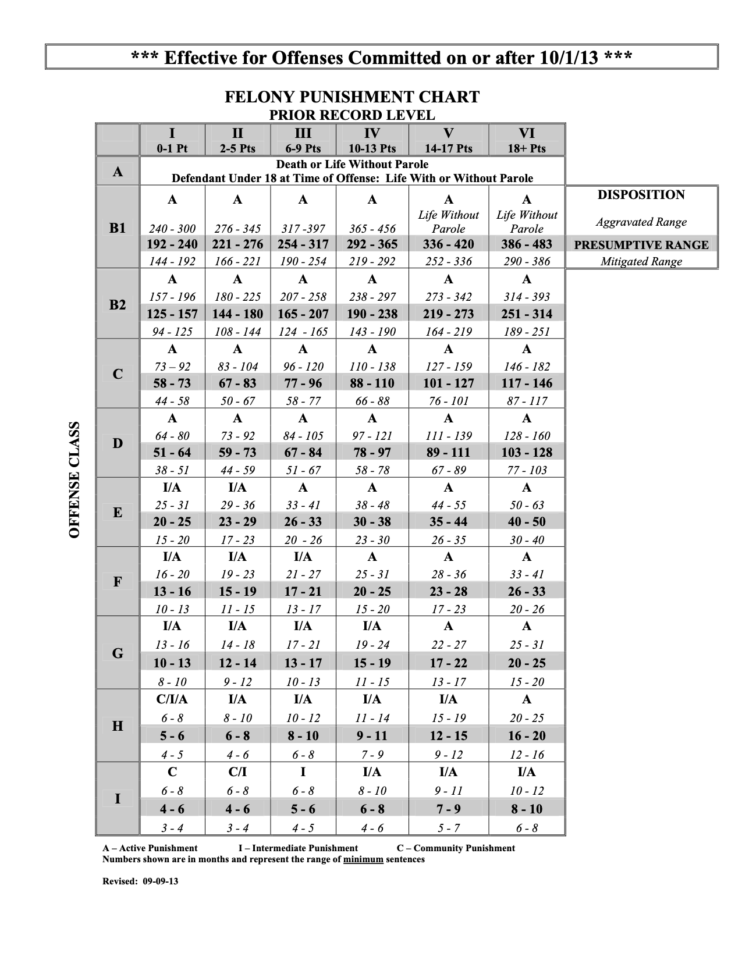
Sentencing
Sentencing Grid
Prior record level
6 – 9 pts
84 – 105
67 – 84
51 - 67
Offense Class
D

Slide 8
Sentencing
Sentencing Grid
Prior record level
6 – 9 pts
84 – 105
67 – 84
51 - 67
Offense Class
D

Slide 9
Sentencing
Sentencing Grid
Sentencing Ranges
Prior record level
6 – 9 pts
Over Sentencing
84 – 105
67 – 84
51 - 67
Aggravated
Offense Class
D
Presumptive
Mitigated
Under Sentencing

Slide 10
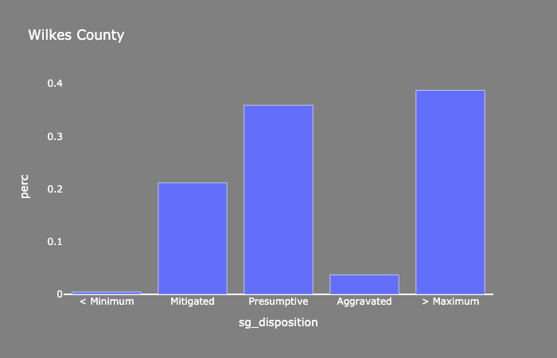
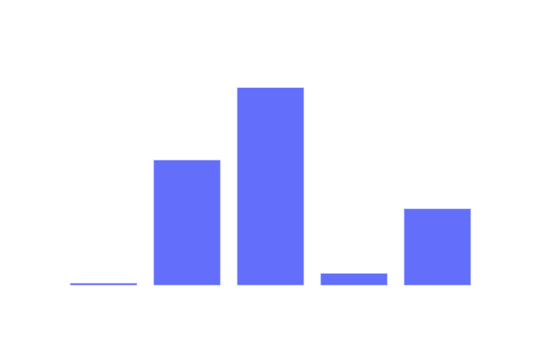
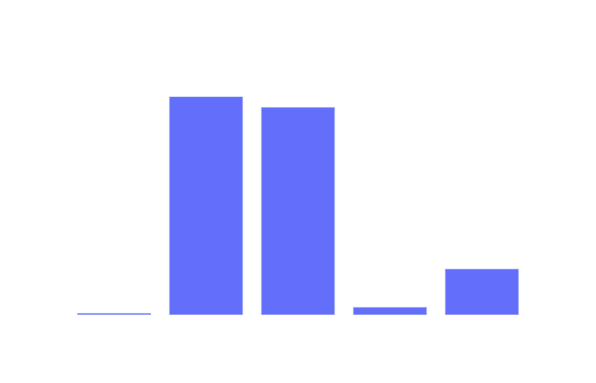
SENTENCING Range
If we plot the distribution of these five ranges at the aggragated level, it will look like this. It's not quite normal, as there are significant portion of cases fall into the over-sentencing bucket (nearly 20%). So the system is actually over-punitive. Furthermore, if we segment it to county level, we can see there are a lot variations as well. These are two counties in NC, the distribution looks very different.
As I said, the system looks over-punitive overall, so for now, let's focus on this over-sentencing range and the geographical variations.
County Level
Aggregated Level

Slide 11
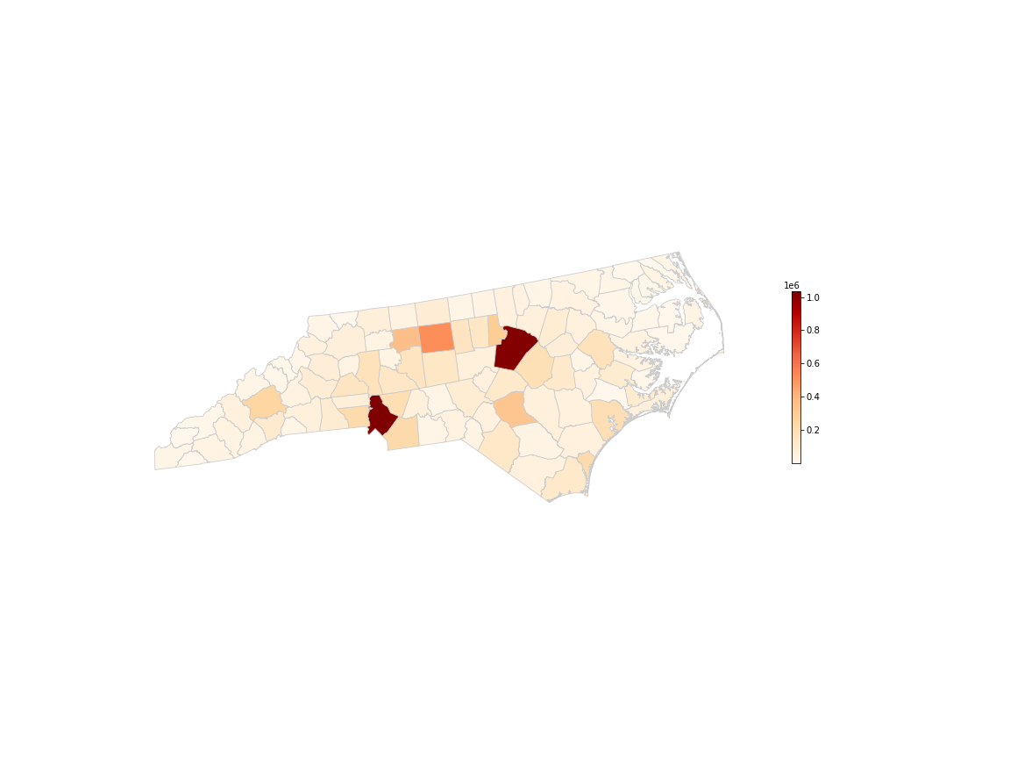
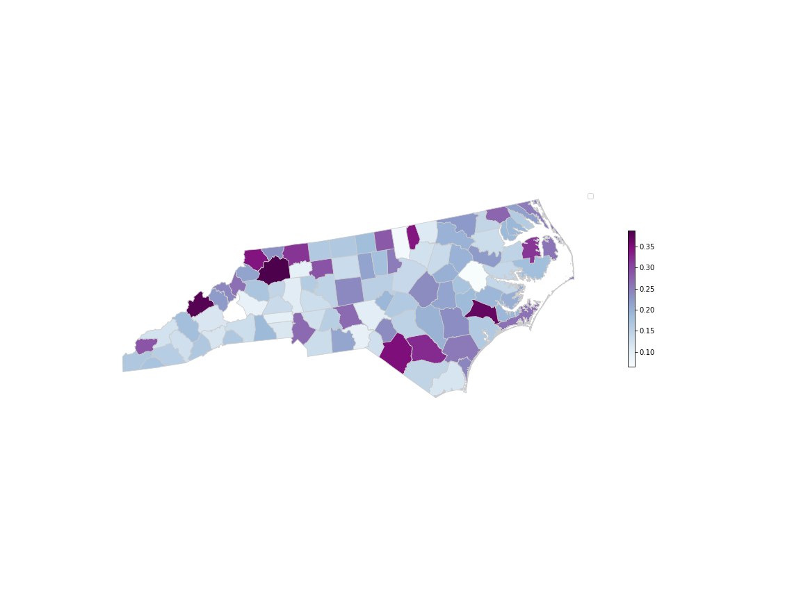
...Over sentenced
Raleigh
Charlotte
Urban vs. Rural

Slide 12
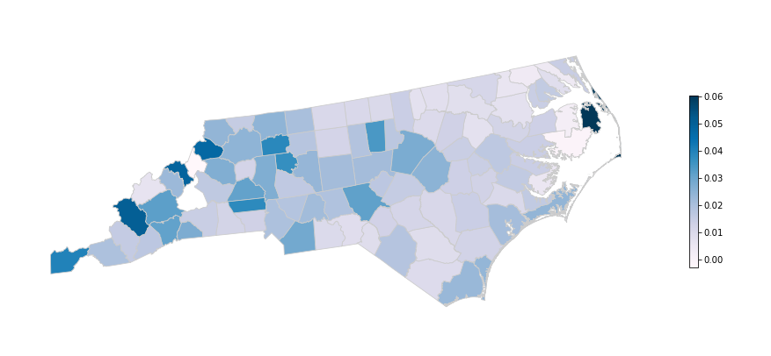
Break down by race…
Percentage Difference
=
% of Black defendants - % of White defendants in over-sentencing range
(normalized by population distribution)

Slide 13
How can we quantify racial/gender bias?
Who is arrested?
Whose charges are dropped/changed?
Who is sentenced to longer in prison?
Notes:
I would like to talk about a part of the process that is often overlooked in this type of analysis and that is the prosecutorial phase the “case journey”
We know that attributing bias to the different players in the system is hard because they divisions of power are not always clearly defined
However, the activities prosecutors conduct, also called INDICTMENT, are interesting because they are often referred to in literature as a BLACK BOX
Authors suggests that the way the justice system is designed in the US made prosecutors end up with unregulated unreviewable power to determine who gets sent to prison and for how long
This is because they conduct plea bargains, which is a negotiation between defendants and prosecutors where they are often offered a ”DEAL” to plead guilty to a smaller number charges or a more lenient offense.

Slide 14





Plea bargain example
Δ Severity = Convicted offenses rank – Initial offense rank
Initial Charged Offenses
Convicted Offenses
Offense | Class
SEX OFFENSE OF CHILD BY ADULT | F
SECOND DEGREE TRESPASS | A
plea bargain
Offense | Class
INDECENT LIBERTIES W/ CHILD | E
Notes:
NOTES
So, I want to pause to recap and review the results I just mentioned:
QUESTIONS?
This is how a normal plea bargaining deal looks like.
…
A prosecutor may offer you to …
…
This leads to some interesting statistics from the dataset we had:
62% of charges (not people) got dismissed by the DA
Only 21% were heard in front of a judge

Slide 15
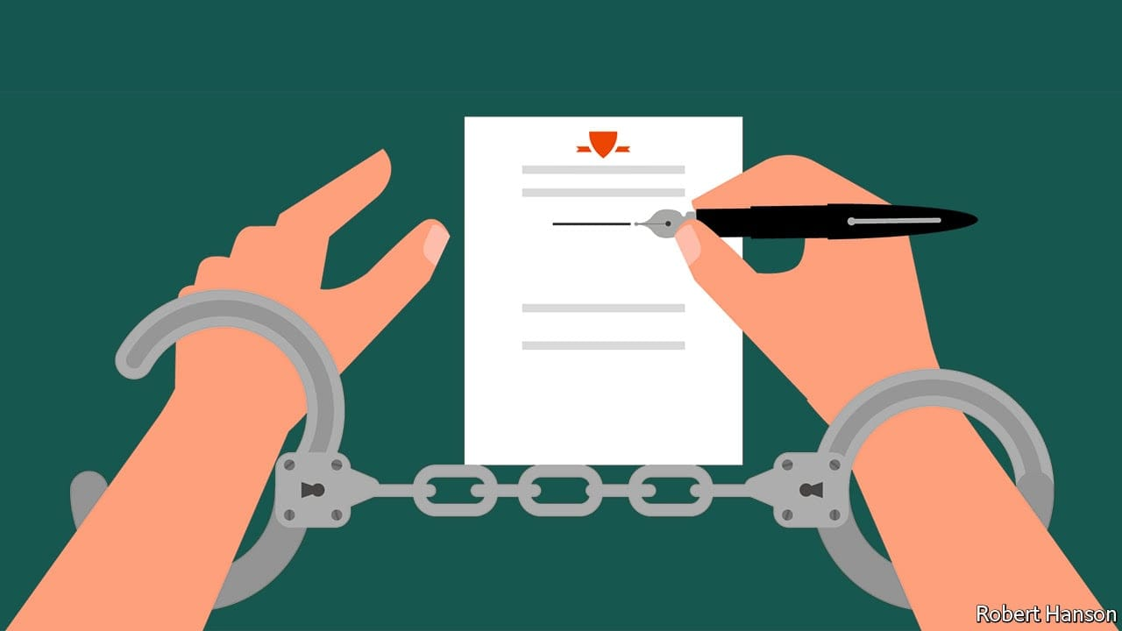
Prosecution
The difference in severity of initial charges compared to convicted charges drops in different amounts, on average, for defendants of different demographics, with substantial variation by court district.
Notes:
NOTES
In trying to estimate how this plea bargain negotiations benefit or harm different people in different degrees, we found that there is, in fact, a significant difference in that leniency deals offered by prosecutors, in return for a guilty plea.
It is important to say that the very vast majority of defendants, when offered a deal, do end up pleading guilty (>94%) and that the current court houses, as they exist, would not be able to hold trials for all the people that enters this system if this wasn’t that way. Even tho there is debate on whether this negotiations are even fair to defendants since there is a clear power imbalance.

Slide 16
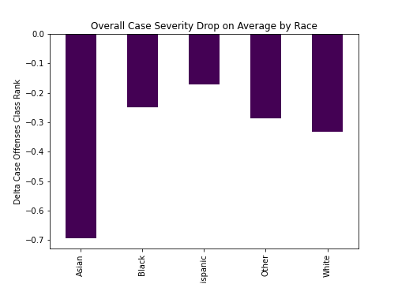
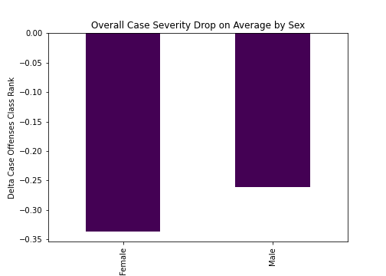
prosecution
Aggregated (State) Level Summary Statistics
Asians seem to be getting the most lenient deals on average, followed by White and then Black defendants.
On average, the aggregated class rank of cases against defendants that are women get a larger drop in severity.
Notes:
It is also important to mention that there is statistically significant variation in the drops when we control for important factors such as the time periods, the defense attorneys, etc.
However, because the severity of the charge is subjective the effects are meaningless, I can only say that the DELTA is ~10%

Slide 17
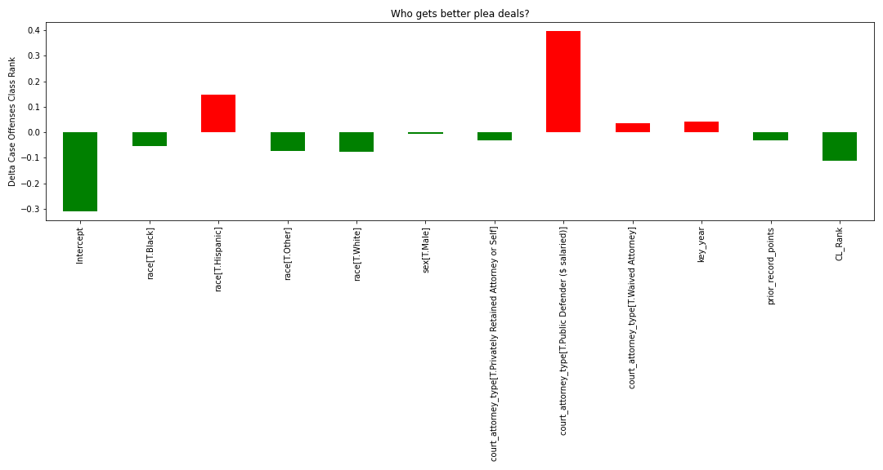
prosecution
$$C\text{ase} \text{Δ} \text{Severity} \text{\sim }\text{year}\text{ + }\text{race}\text{ + }\text{sex}\text{ + }\text{prior} \text{record} \text{points}\text{ + }\text{attorney} \text{type}\text{ + }\text{initial} \text{case} \text{rank}$$
When controlling for other factors such as the type of defense attorney, bench, year, etc., there we see that the average drop is 9% larger for White defendants compared to Black, and 50% for Hispanic compared to White.
The largest negative contributor to plea deals is the attorney type.
Notes:
It is also important to mention that there is statistically significant variation in the drops when we control for important factors such as the time periods, the defense attorneys, etc.
However, because the severity of the charge is subjective the effects are meaningless, I can only say that the DELTA is ~10%

Slide 18
How can we quantify racial/gender bias?
Who is arrested?
Whose charges are dropped?
Who is sentenced to longer in prison?
Notes:
Prosecutor duties by American Bar Association: https://www.americanbar.org/groups/criminal_justice/standards/ProsecutionFunctionFourthEdition/#:~:text=The%20prosecutor%20should%20seek%20to,persons%2C%20including%20suspects%20and%20defendants.
“the prosecutor's primary function is to initiate and conduct criminal action, to act as a party in judicial proceedings and, in many countries, to supervise and direct the police during the investigative phase. In some criminal justice systems, prosecutors also: ensure that victims are effectively assisted; decide on alternatives to prosecution; offer assistance to the court in reaching its decision as to the appropriate sentence; supervise the execution of court decisions.”
States are not required to charge by use of a grand jury.

Slide 19
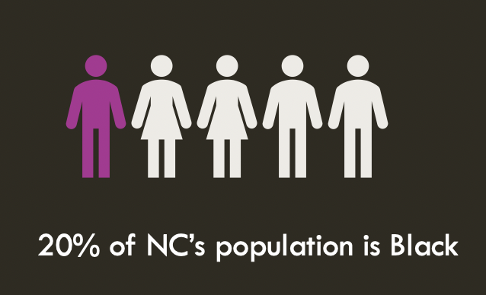
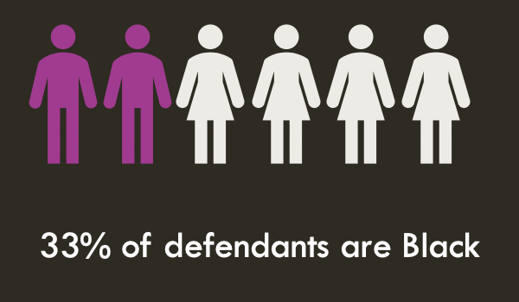
Black people are over-represented in the system

Slide 20
Black people are over-represented in the system
There is a 13 %-point difference, on average, indicating that Black people are over-represented in the arrested population of NC
Notes:
Possible reasons for disparity:
- racial bias in policing
- commit easier to catch crimes
- Black people commit more crimes

Slide 21
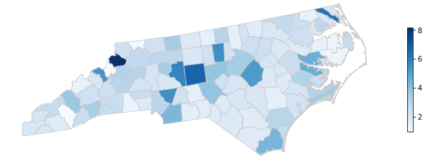
Watauga County
(8 times)
In NC, a Black person is 2.7 times more likely to be arrested than a White person​
Jackson County (0.96 times)

Slide 22
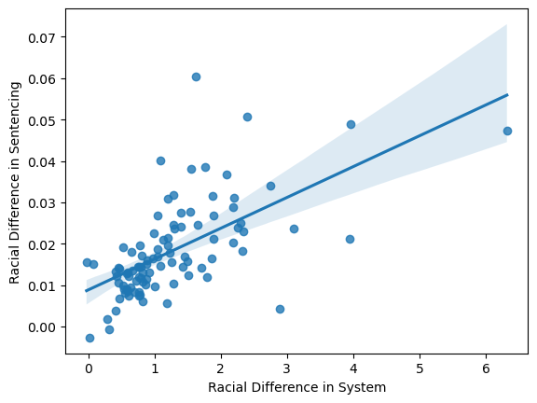
Are racially biased counties in sentencing also more racially biased in arrests?

Slide 23
Conclusions
Our findings support some claims that are seen often in this field’s literature:
The Justice System at the district court level is more often over-punitive than not, with high variation across counties/benches.
The plea-bargain negotiations are hard to track and highly variable across benches. We observed a higher leniency for White defendants compared to Black and Hispanic as well as a higher drop for woman compared to men. There are many reasons why this is could be happening. Systemic racism remains a plausible reason.
Being in contact with the court system is intrinsically punitive (defendants pay court fees, miss work, are exposed to civil forfeiture, etc.), there is a clear racial disparity in the rate of being involved in a criminal case. This also varies by counties.
District courts where Black people are overrepresented are the same ones that are being more punitive in sentence length with Black people compared to White
Notes:
Voting can change prosecutors, that's the part you can play!

Slide 24
Thank you !
Much gratitude to
Nick Eubank, Will, and Jude

